Slide 1
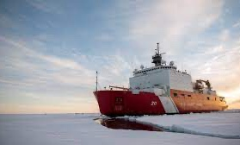
ADAC Year 7 Annual Meeting
...Via Conference Call, 2-3 June 2021
ADAC Project Briefing
Arctic Ice Condition Index
Jifeng Peng, University of Alaska Anchorage
Shawn Butler, University of Alaska Anchorage
Jinlun Zhang, University of Washington
Kelsey Frazier, University of Alaska Anchorage

Slide 2




ADAC Project: Arctic Ice Conditions Index (ARCTICE)
ADAC Program Year 7 Annual Meeting 2-3 June 2021
Project team
  Dr. Jifeng Peng, University of Alaska Anchorage
  Dr. Shawn Butler, University of Alaska Anchorage
  Dr. Jinlun Zhang, University of Washington
  Kelsey Frazier, University of Alaska Anchorage

Slide 3
ADAC Project: Arctic Ice Conditions Index (ARCTICE)
ADAC Program Year 7 Annual Meeting 2-3 June 2021
Project Champions
  CDR Christopher Tuckey, CG-WWM
Project Support
  Karin Messenger, CG RDC
  Sam Cheung, CG, RDC
Project Collaborators
  Jonathan Edwards-Opperman, NIC
  Capt. (Ret) Phillip Thorne, CG D17
  Axiom Data Science

Slide 4
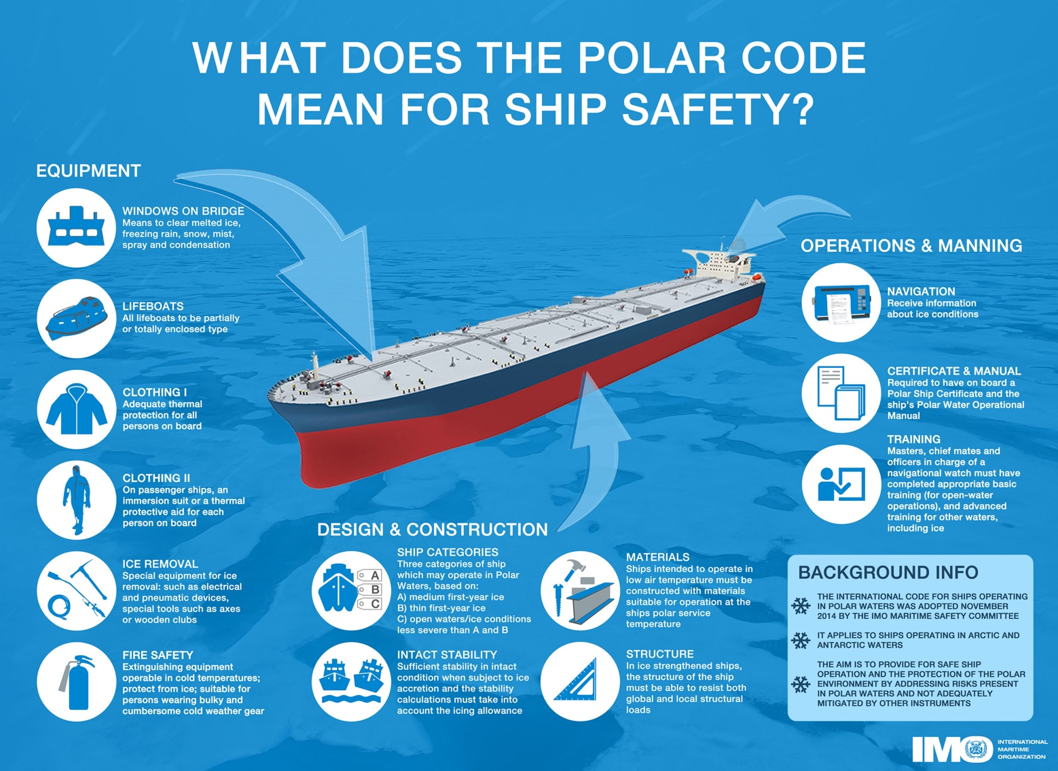
ADAC Program Year 7 Annual Meeting 2-3 June 2021
Arctic Ice Conditions Index (ARCTICE)
Description and Baseline
Leveraging team and research skills which developed Great Lakes ICECON, project ARCTICE will develop a high-resolution ice condition index for U.S. Arctic Maritime Exclusive Economic Zone (EEZ), including Bering, Chukchi and Beaufort Sea regions
ARCTICE produces an easy-to-understand numeral to communicate ice conditions that are relevant to the capabilities of an individual vessel. This index will be available for current and future ice conditions, providing forecasts up to 1 month in advance
ARCTICE supports vessel captains and officers in route planning and determining associated risk for traveling through a region of Arctic water

Slide 5
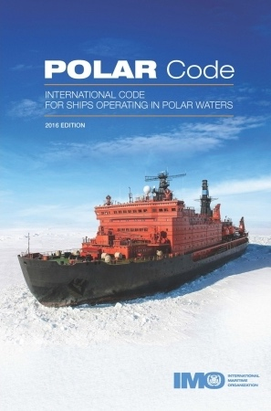
Arctic Ice Conditions Index (ARCTICE)
Description and Baseline
Historically many Arctic nations use their own methods for communicating ice conditions. Following the addition of the “POLARIS amendment” to the International Maritime Organization (IMO) Polar Code, communication tools on ice conditions started to migrate to a uniform methodology.
The POLARIS amendment to the IMO Polar Code is based on vetted ice condition processes from the Canadian AIRSS system, the Russian Ice Certificate concept, and additional inputs from other coastal administrators.
While the IMO has no existing or planned international enforcement privileges, the IMO Polar Code is seen as a “best practices” guide, many nations require that vessels comply with the Polar Code.

Slide 6
ADAC Program Year 7 Annual Meeting 2-3 June 2021
Arctic Ice Conditions Index (ARCTICE)
Relevance to DHS and USCG
  Exponential increases in ship traffic through US Arctic EEZ
  Foreign industry is transporting LNG through Chukchi and Bering Sea year round, attracting interest from other companies and nations
  Arctic mariners experience long distances between ports of call, communication shortfalls, increasingly unpredictable weather patters, and limited USCG SAR availability
  Vessels historically have travelled through the ice without knowledge of potential risks from the sea ice, sometimes getting stuck and needing assistance

Slide 7
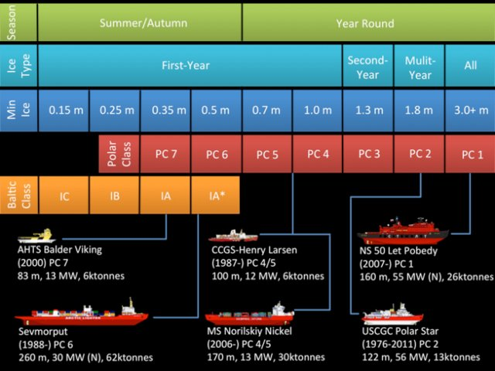
ADAC Program Year 7 Annual Meeting 2-3 June 2021
Arctic Ice Conditions Index (ARCTICE)
Prior Work Completed
Provide and confirm the ARCTICE vessel classification index. The Polar Code uses the International Association of Classification Society (IACS) Polar Class Unified Requirements and the Finnish-Swedish Ice Class Rules (Baltic Ice Class). The project team has identified the correlation between the Polar Class/Baltic Ice Class and the ABS Ice Class.
Season of the year →
Ice type →
Ice thickness →
Polar Classification →
Baltic Classification →

Slide 8
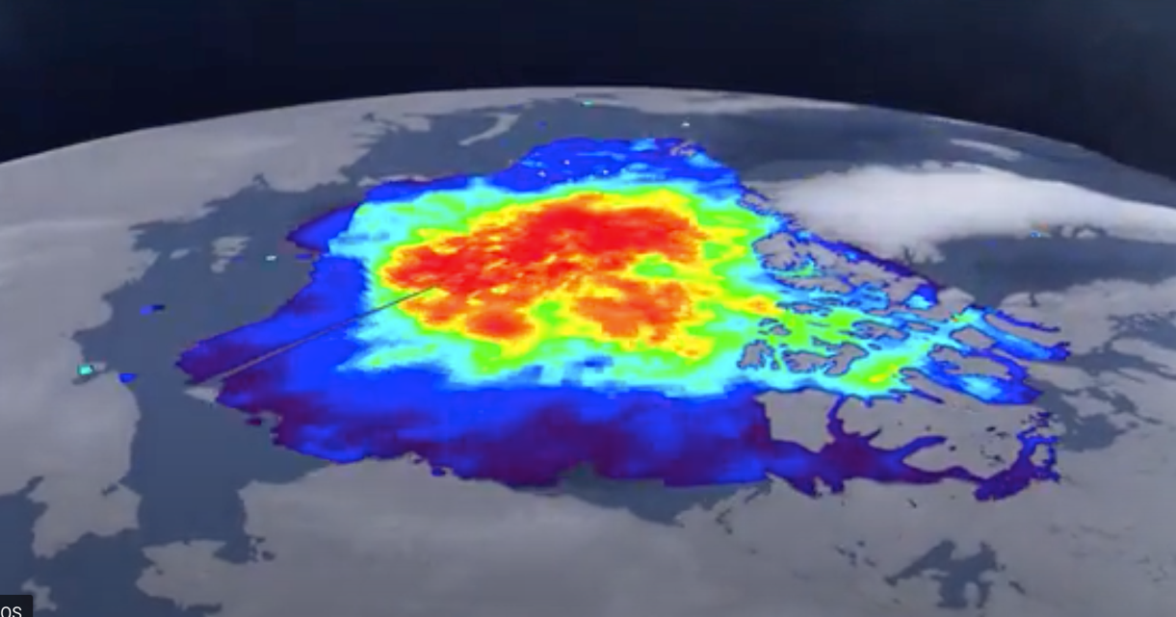
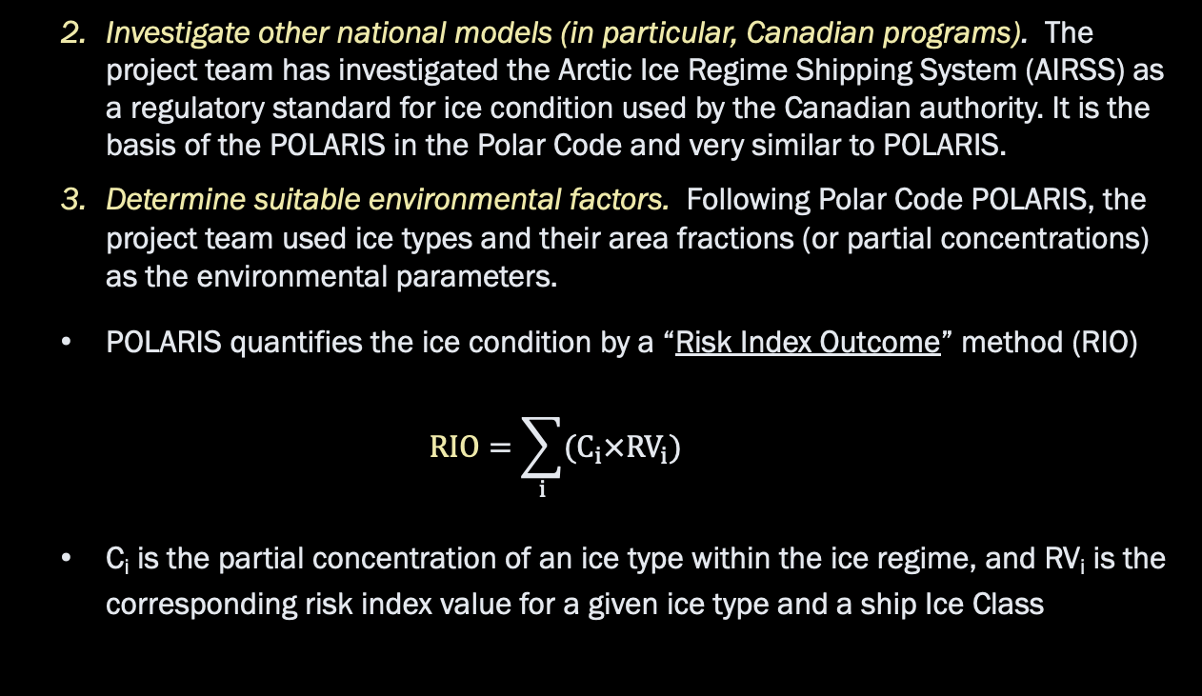
ADAC Program Year 7 Annual Meeting 2-3 June 2021
Arctic Ice Conditions Index (ARCTICE)
Prior Work Completed
Investigate other national models (in particular, Canadian programs). The project team has investigated the Arctic Ice Regime Shipping System (AIRSS) as a regulatory standard for ice condition used by the Canadian authority. It is the basis of the POLARIS in the Polar Code and very similar to POLARIS.
Determine suitable environmental factors. Following Polar Code POLARIS, the project team used ice types and their area fractions (or partial concentrations) as the environmental parameters.
  POLARIS quantifies the ice condition by a “Risk Index Outcome” method (RIO)
$$RIO=\sum_{i}{(C_{i}×{RV}_{i})}$$
  C_{i} is the partial concentration of an ice type within the ice regime, and RV_{i} is the corresponding risk index value for a given ice type and a ship Ice Class
HIOMAS https://arcticdomainawarenesscenter.org/P08_HIOMAS

Slide 9
ADAC Program Year 7 Annual Meeting 2-3 June 2021
Arctic Ice Conditions Index (ARCTICE)
Prior Work Completed
Environmental inputs come from ADAC’s High Resolution Ice-Ocean Modeling and Assimilation System (HIOMAS)
Selected High-resolution Ice-Ocean Modeling and Assimilation System (HIOMAS) model :
  ice and ocean current forecast data on high-resolution (1 km) grid for US Arctic EEZ
  forecast of ice condition up to 1 month
  spatial distribution of ice motion and thickness
  the area fraction of thick-ridged or multi-year ice
HIOMAS: https://arcticdomainawarenesscenter.org/P08_HIOMAS
Updating HIOMAS model:
  In the original HIOMAS, there are 8 ice categories for partial sea ice concentration provided as output;
  The ARCTICE algorithm received these categories, then linear interpolation was employed to calculate the 12 partial sea ice concentrations the Polaris RIO requires;
  To increase the accuracy of ARCTICE, an updated HIOMAS model was established in which the partial sea ice concentration output increased from 8 categories to 24.

Slide 10
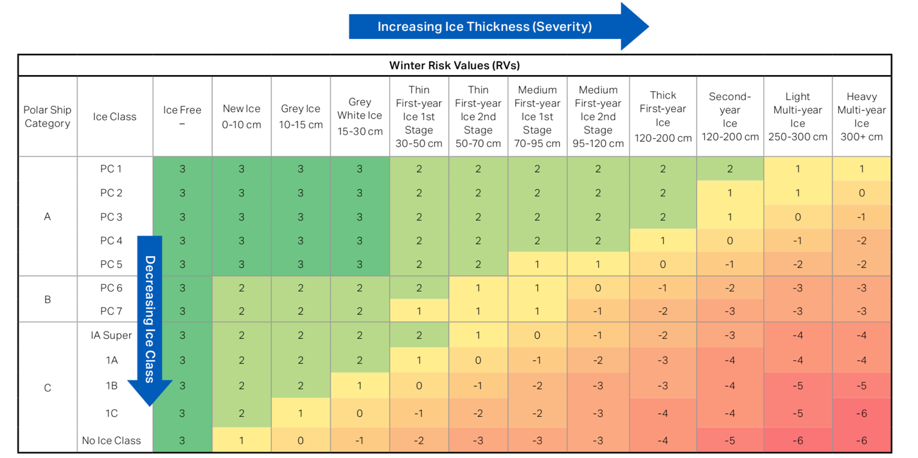
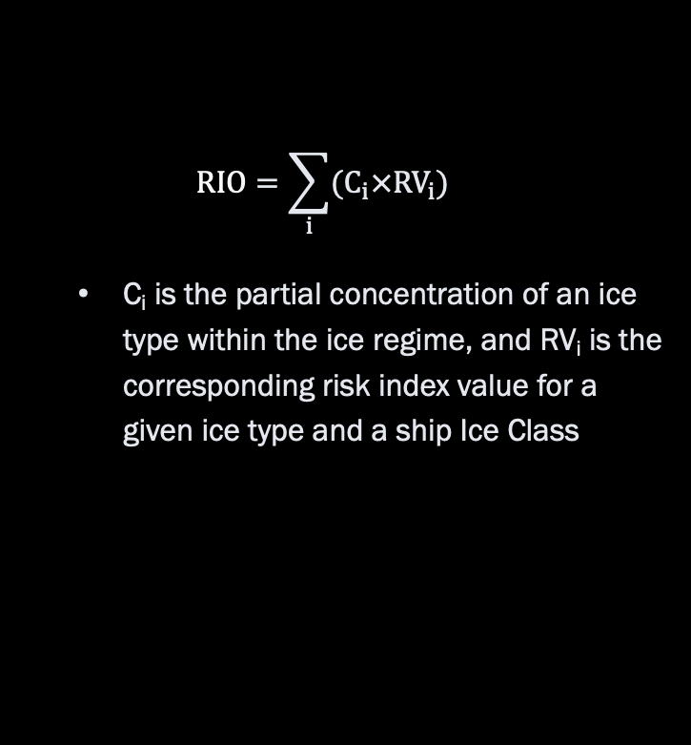
ADAC Program Year 7 Annual Meeting 2-3 June 2021
Arctic Ice Conditions Index (ARCTICE)
Prior Work Completed
$$RIO=\sum_{i}{(C_{i}×{RV}_{i})}$$
  C_{i} is the partial concentration of an ice type within the ice regime, and RV_{i} is the corresponding risk index value for a given ice type and a ship Ice Class

Slide 11
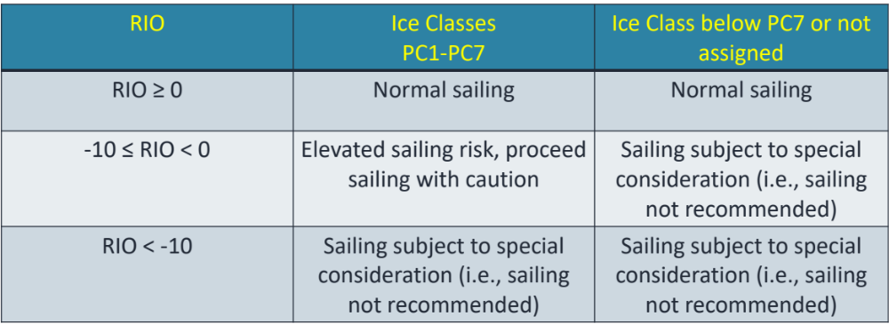
ADAC Program Year 7 Annual Meeting 2-3 June 2021
Arctic Ice Conditions Index (ARCTICE)
Prior Work Completed
ARCTICE decision thresholds:
As the RIO value decreases (gets more negative) the risk of significant vessel/ice interactions increases

Slide 12
ADAC Program Year 7 Annual Meeting 2-3 June 2021
Arctic Ice Conditions Index (ARCTICE)
Prior Work Completed
Create, then optimize a forecast numeric Arctic ice condition index for Arctic waters. A computer code has been developed to generate the POLARIS index for various Polar Class vessels.
Investigate suitable access. Ensuring ease of access to ARCTICE for the Arctic mariner is a particular challenge for this project. Output from the ARCTICE system needs to consider that operators will utilize satellite data for access and bandwidth will be limited. The team discussed with USCG D17 for the most suitable approach to publish the Ice Condition Index for easy access for mariners.

Slide 13
ADAC Program Year 7 Annual Meeting 2-3 June 2021
Arctic Ice Conditions Index (ARCTICE)
Research Tasks for Year 7
Finalize the integration of the index to a visualization tool as an aid to vessel mariner planning and underway activities. COMPLETED
Automate a forecast numeric Arctic ice condition index for Arctic waters. COMPLETED
Conduct ARCTICE validation. COMPLETED
Transition the ARCTICE to an operational destination. COMPLETED

Slide 14
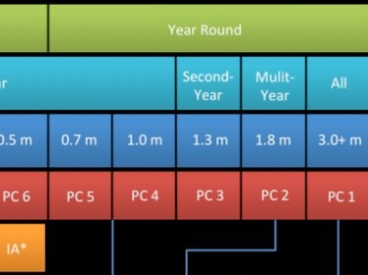
ADAC Program Year 7 Annual Meeting 2-3 June 2021
Arctic Ice Conditions Index (ARCTICE)
Task 1: Finalize the integration of the index to a visualization tool as an aid to vessel mariner planning and underway activities

Slide 15
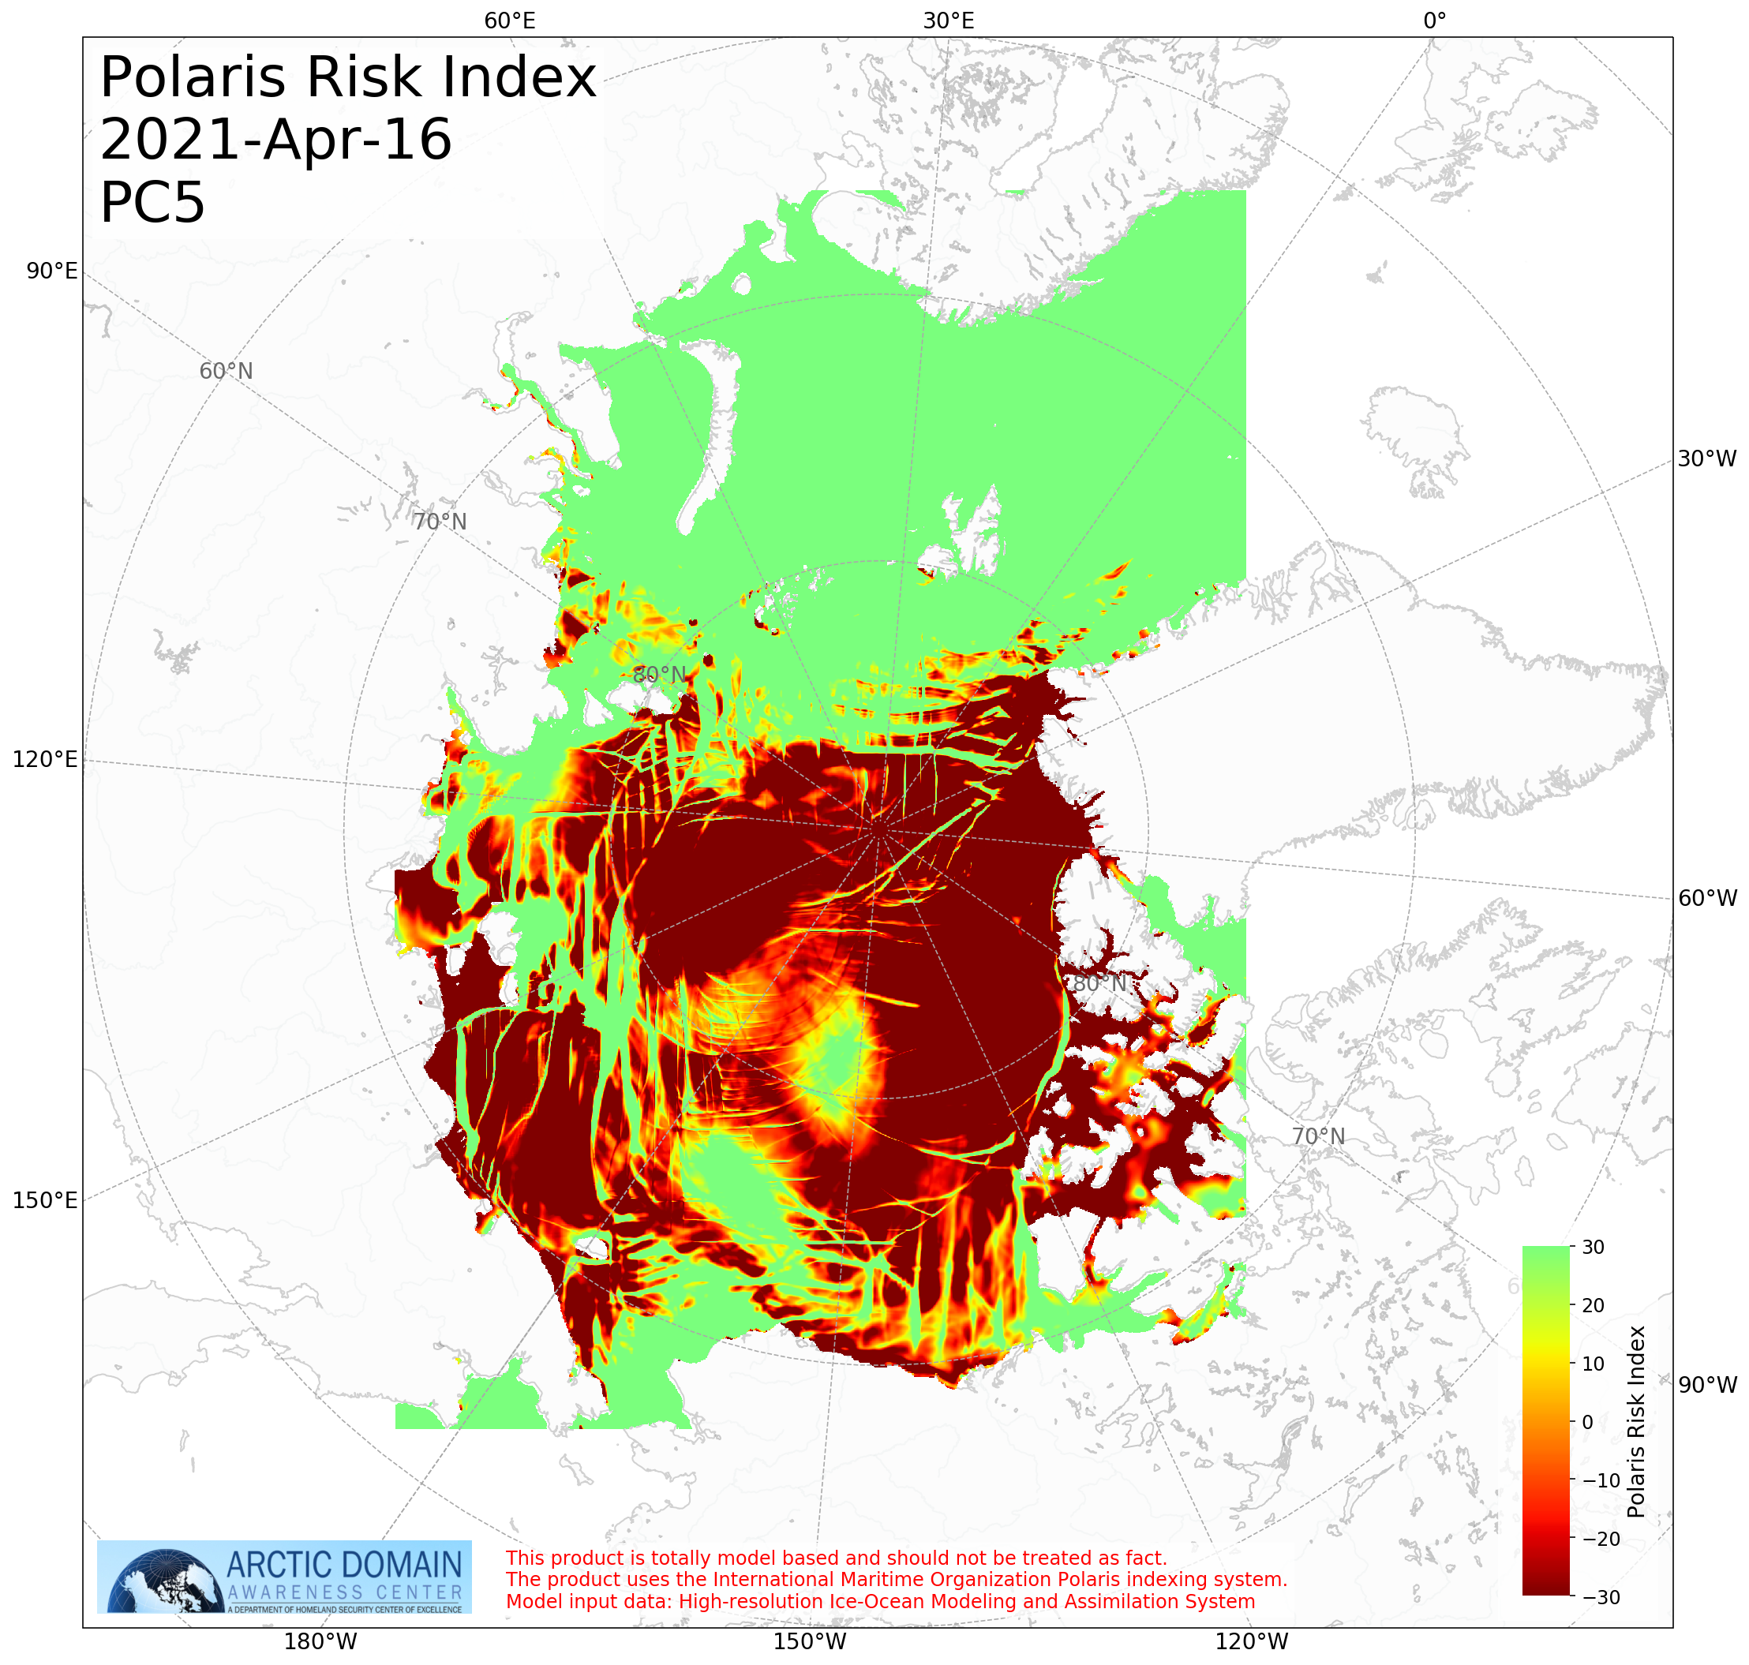
ADAC Program Year 7 Annual Meeting 2-3 June 2021
Arctic Ice Conditions Index (ARCTICE)
Task 1: Finalize the integration of the index to a visualization tool as an aid to vessel mariner planning and underway activities
The “claw marks” in the plot are caused by “leads” in the ice. As the ice moves, it separates and reveals the ocean’s surface. These open areas are leads. Ice regrows here but will be thinner and that’s what makes those claw marks.

Slide 16
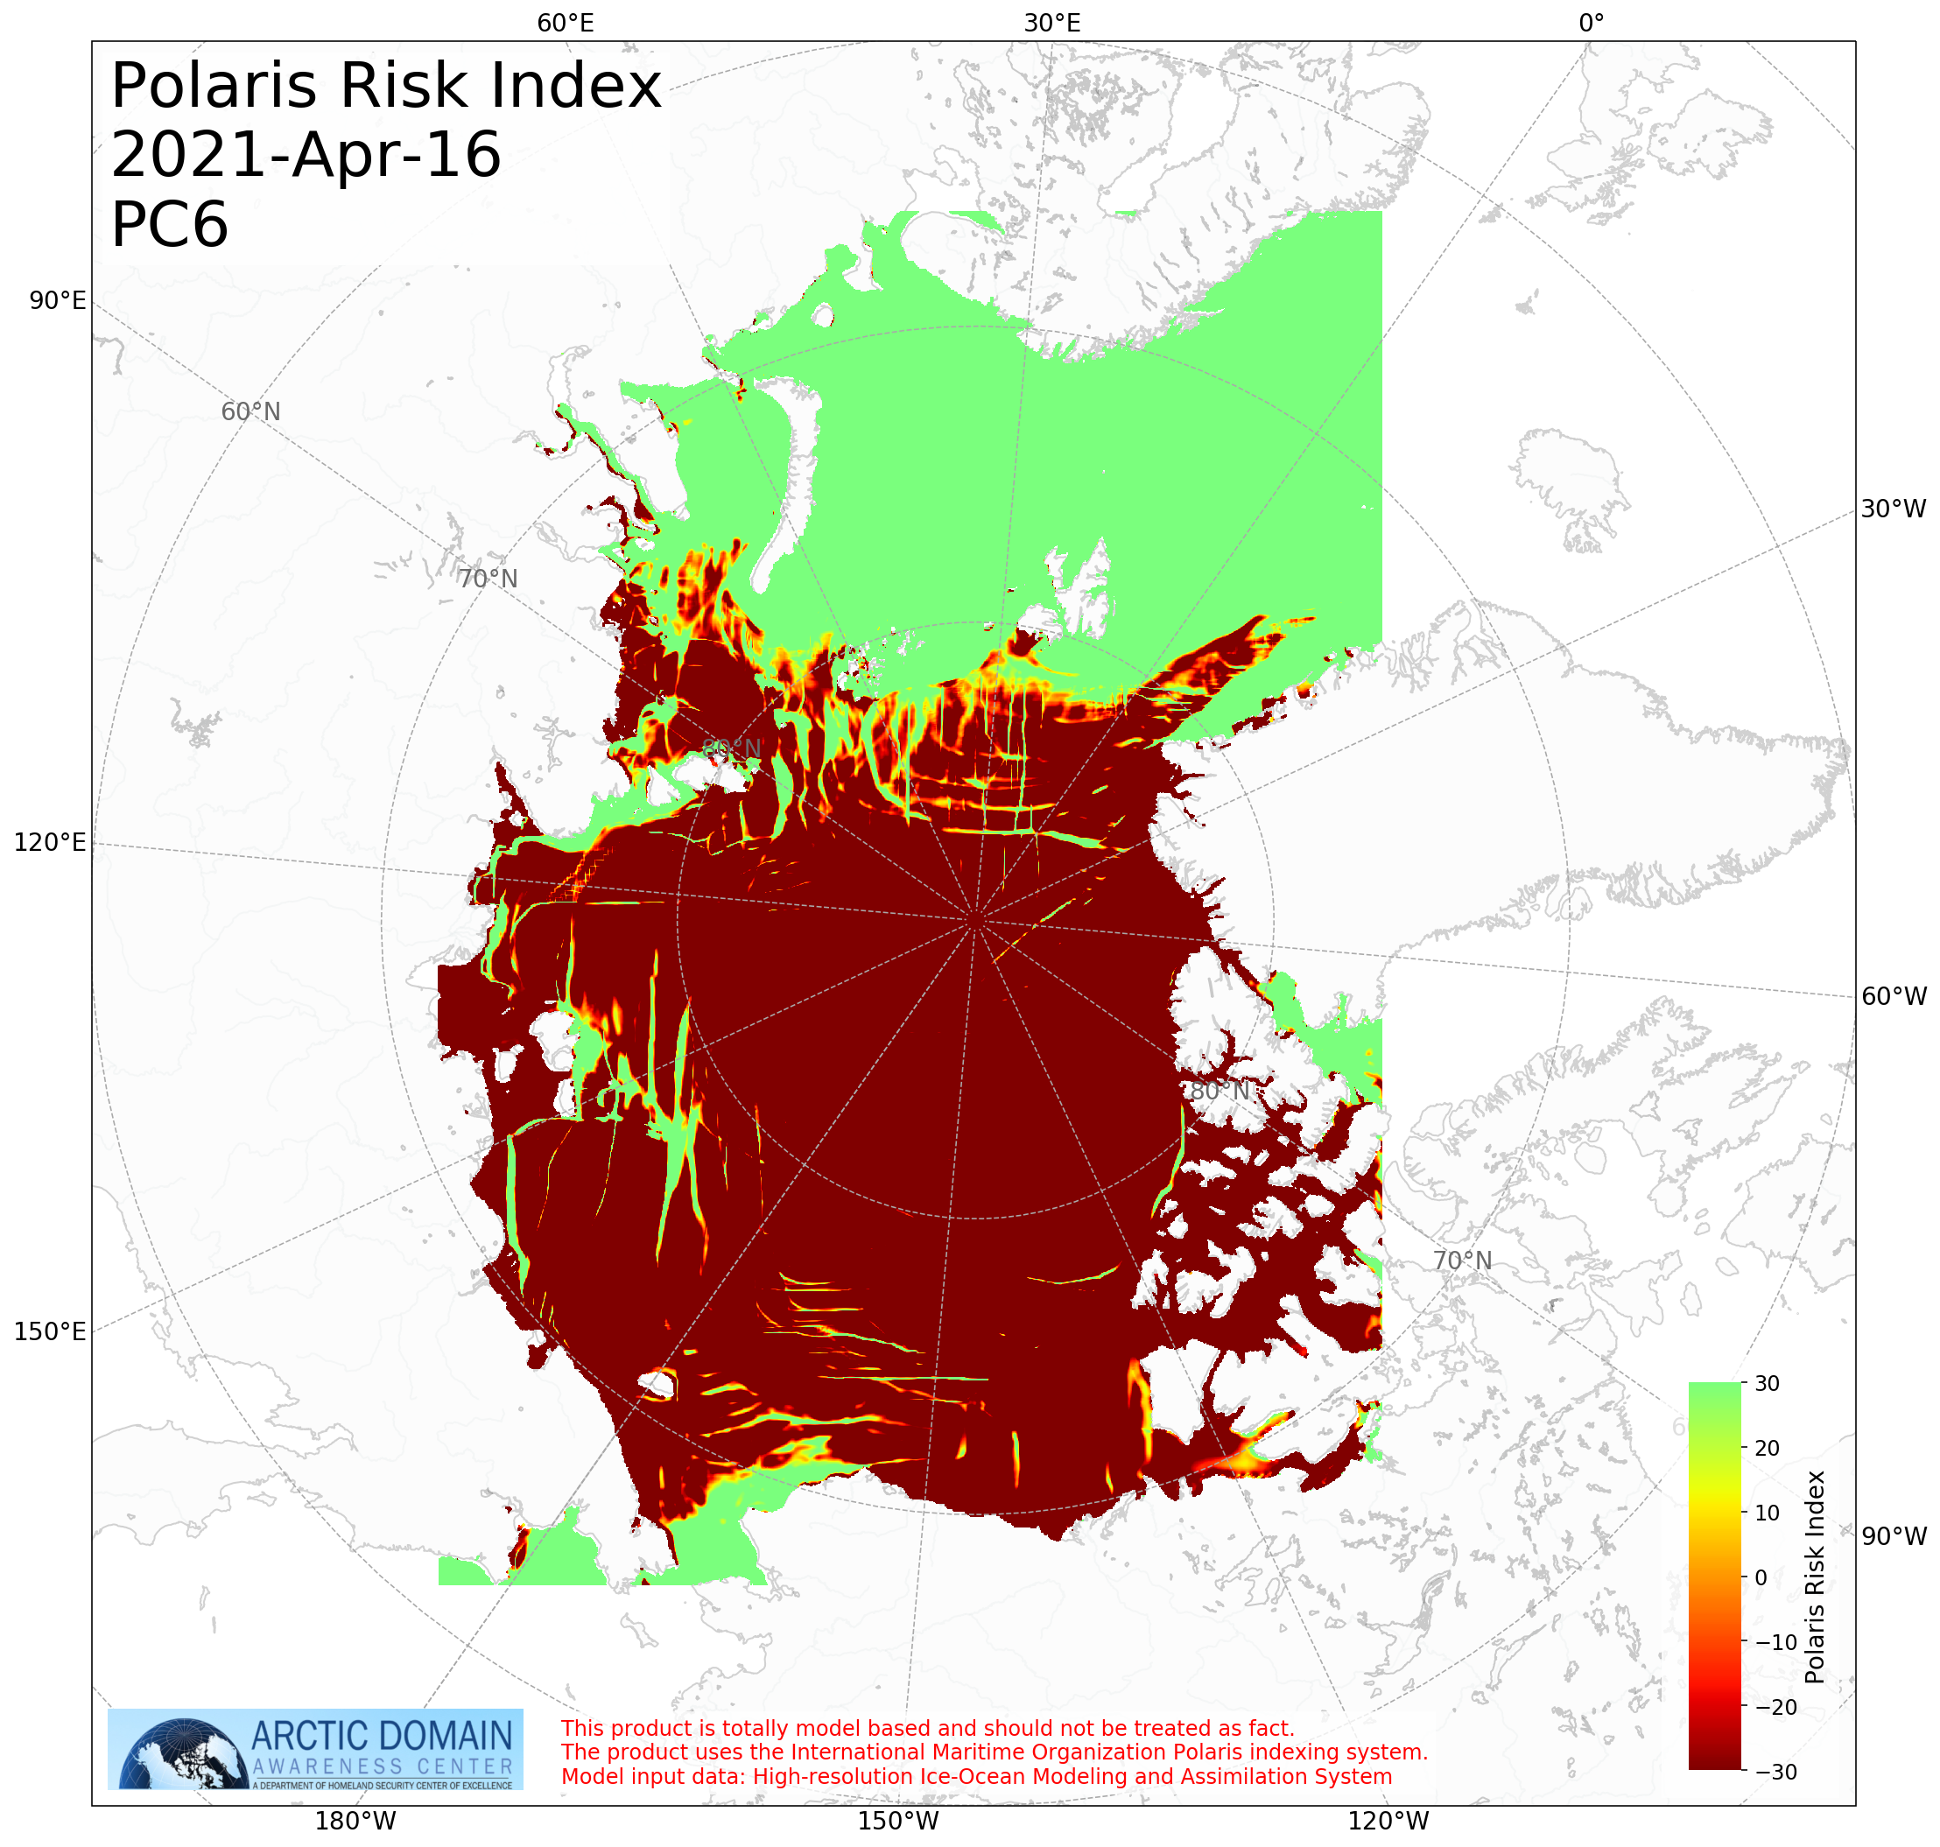
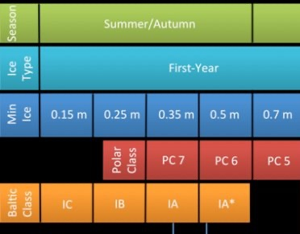
ADAC Program Year 7 Annual Meeting 2-3 June 2021
Arctic Ice Conditions Index (ARCTICE)
Task 1: Finalize the integration of the index to a visualization tool as an aid to vessel mariner planning and underway activities

Slide 17
ADAC Program Year 7 Annual Meeting 2-3 June 2021
Arctic Ice Conditions Index (ARCTICE)
Task 2: Automate a forecast numeric Arctic ice condition index for Arctic waters &
Task 3: Conduct ARCTICE validation
The ADAC team and project partner Axiom Data Science established a new python script for automatic calculation;
Sanity check of the manual product;
Parsed the HIOMAS data as input data for ARCTICE;
Generated plots in .png and geotiff formats;
ARCTICE (based on 24-category-ice HIOMAX) fully operational on Axiom server, completed in Q3.

Slide 18
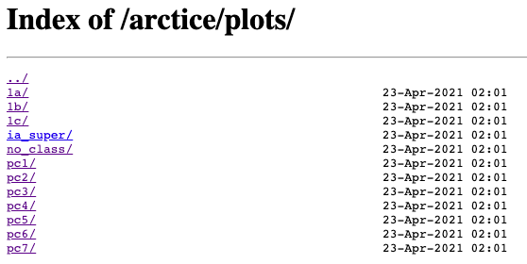
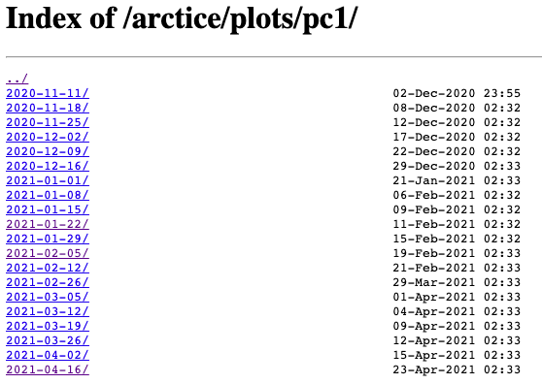
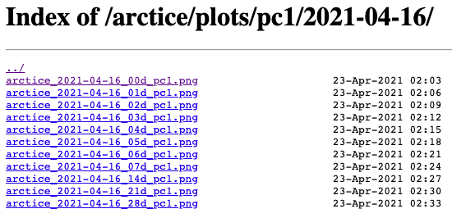
ADAC Program Year 7 Annual Meeting 2-3 June 2021
Arctic Ice Conditions Index (ARCTICE)
Task 4: Transition the ARCTICE to an operational destination
Product web server up: https://static-plotter-web.srv.axds.co/arctice/plots/
Each class has a list of plots produced weekly. Historic plots available.
Polar classes 1-7, Baltic classes ia super, 1a, 1b, 1c, and vessels with ‘no class’ for ice
Now cast (current day, each day for the present week, then 14, 21, and 28 days in advance

Slide 19
ADAC Program Year 7 Annual Meeting 2-3 June 2021
Arctic Ice Conditions Index (ARCTICE)
Task 4: Transition the ARCTICE to an operational destination
Further potential improvement
  Currently each ARCTICE plot is individually listed;
  To make it easier to navigate, upgrade to combine the individual plots into a single file;
  Exploring other improvements such as front-facing website with thumbnails or geotifs for ArcGIS (year 8 task).

Slide 20
ADAC Program Year 7 Annual Meeting 2-3 June 2021
Arctic Ice Conditions Index (ARCTICE)
Additional Work
Outreach: presentations include ASIP 2020, Arctic C-ICE, Qilak LNG, and NSF NNA Arctic Shipping project.
Potential ARCTICE case study using observed conditions from USCGC Healey (Summer 2022).
Considering user experience for ARCTICE display and modes of interaction
Journal article for ARCTICE underway. Team plans to have the article ready for center review at the end of May, out for peer review in June 2021.

Slide 21
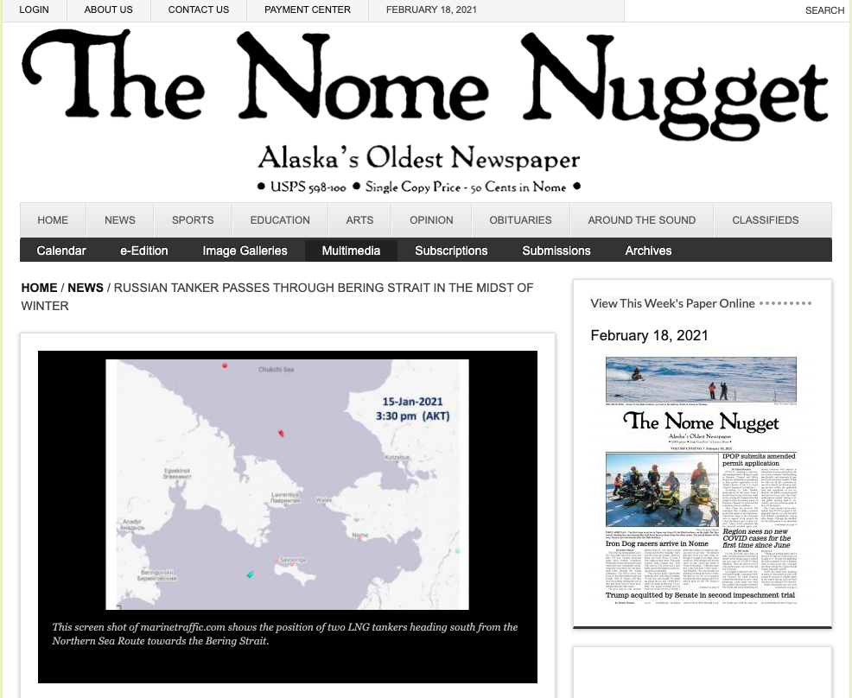
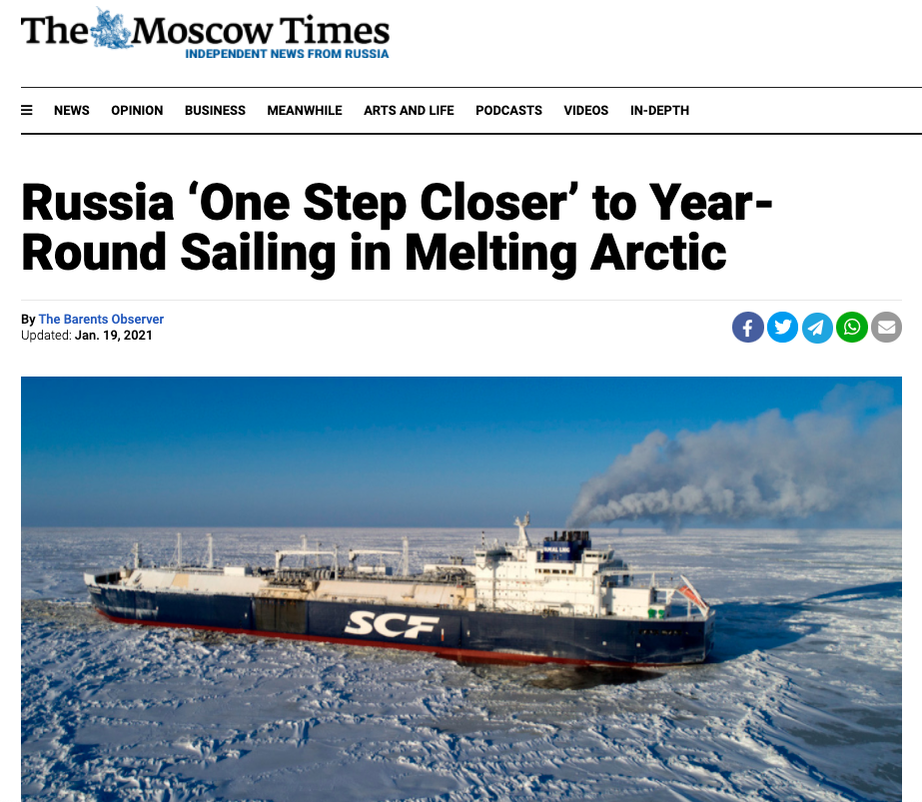
ADAC Program Year 7 Annual Meeting 2-3 June 2021
Arctic Ice Conditions Index (ARCTICE)
Case Study: Russian LNG
January 2021, Russian LNG tankers traversed the Northeast Passage, from Sabetta LNG terminal on Yamal Peninsula to China
No icebreaker escort – 10 days to cover 2474 n. miles (~9.5 knots)

Slide 22
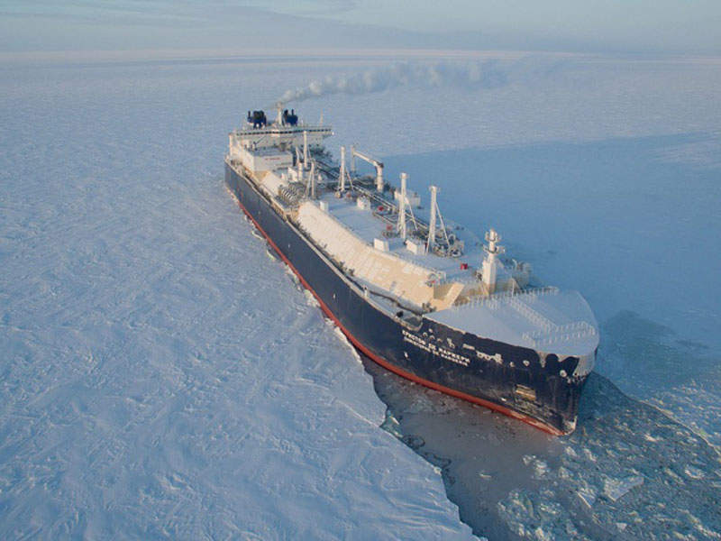
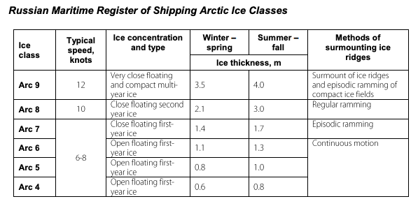
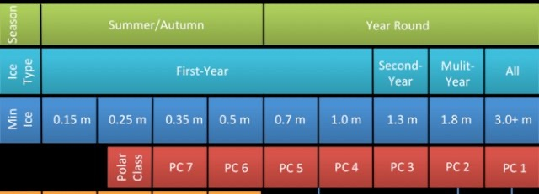
ADAC Program Year 7 Annual Meeting 2-3 June 2021
Arctic Ice Conditions Index (ARCTICE)
Case Study: Russian LNG
Photo reference: https://www.ship-technology.com/projects/christophe-de-margerie-class-icebreaking-lng-carriers/

Slide 23
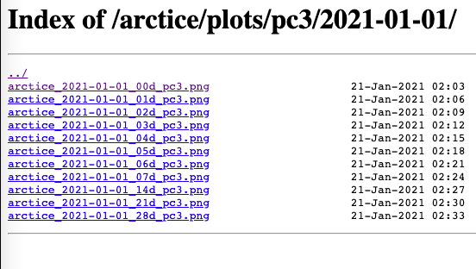
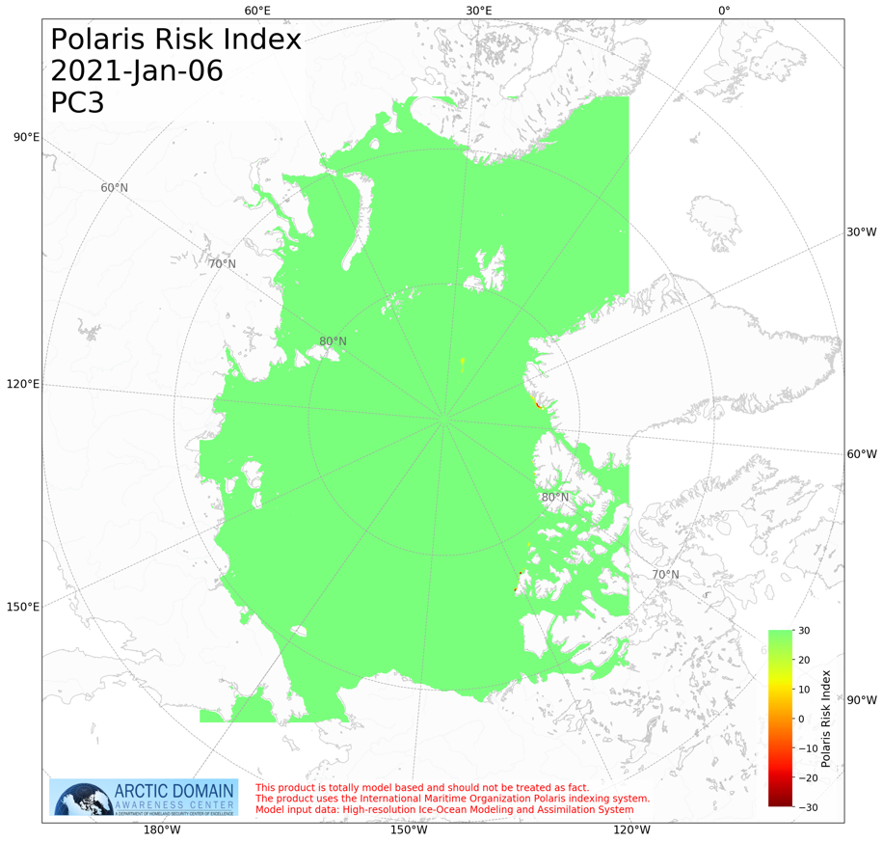
ADAC Program Year 7 Annual Meeting 2-3 June 2021
Arctic Ice Conditions Index (ARCTICE)
Case Study: Russian LNG
News outlets state the ‘Christophe de Margerie’ left port January 5 and passed through the Bering Strait on January 16, 2021 having traveled in “thick” sea ice during that time
ARCTICE ran Jan 1, predicting ice conditions up to 28 days in advance

Slide 24
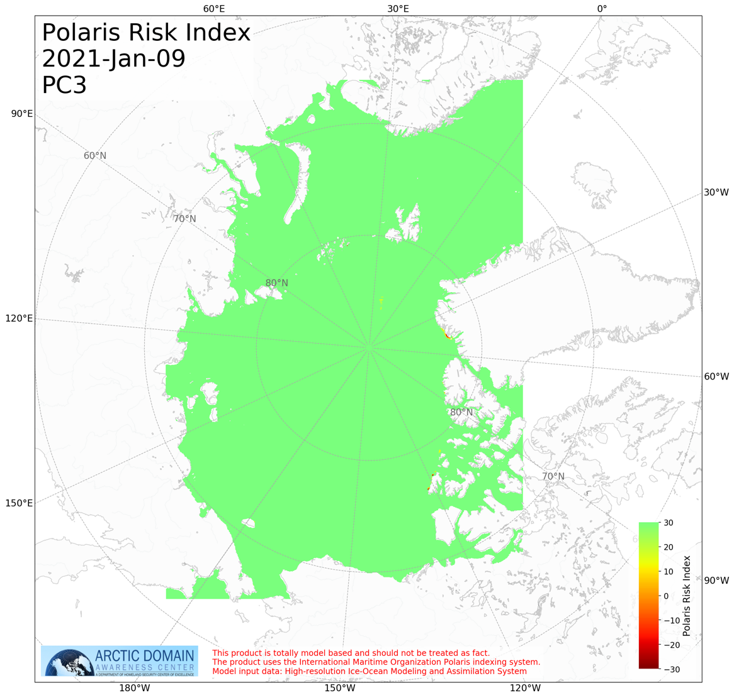

ADAC Program Year 7 Annual Meeting 2-3 June 2021
Arctic Ice Conditions Index (ARCTICE)
Case Study: Russian LNG
Route planning may include pulling the predicted ice conditions

Slide 25
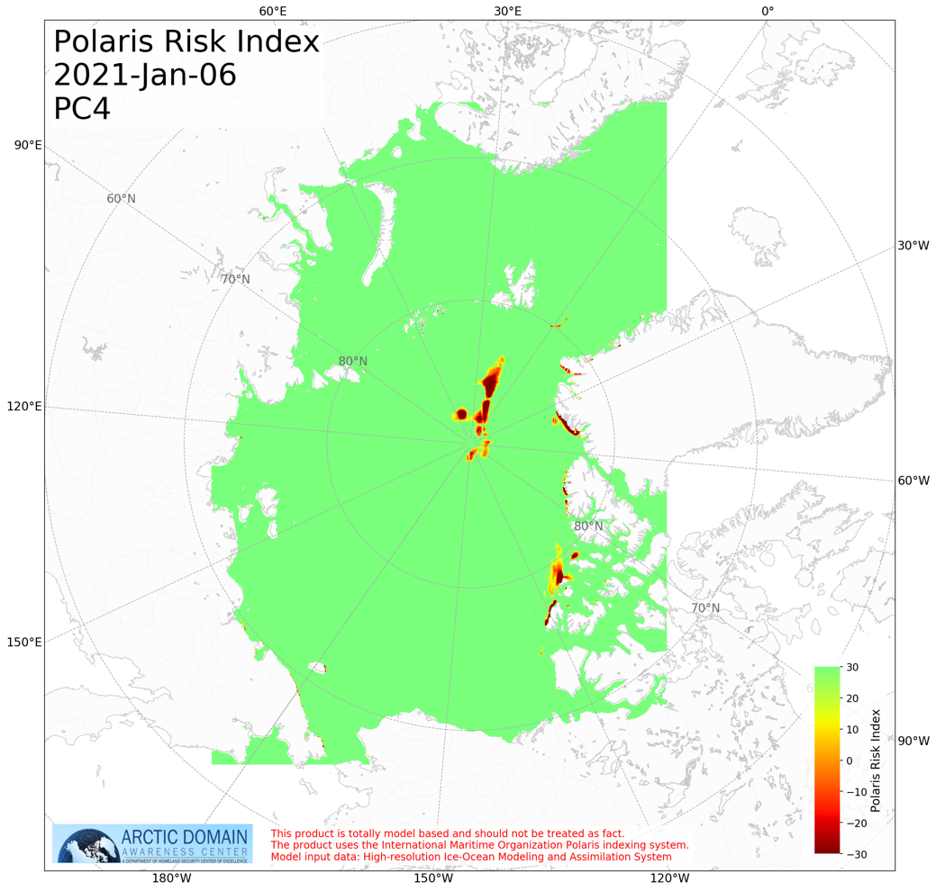
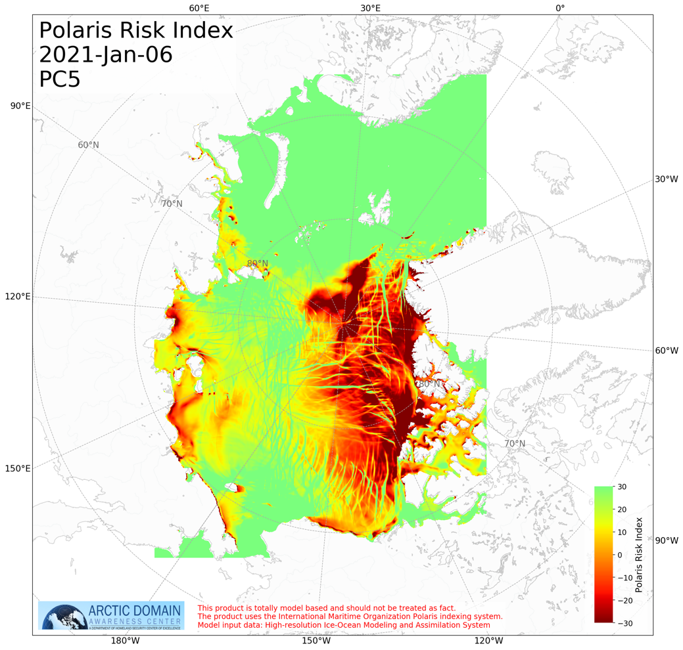
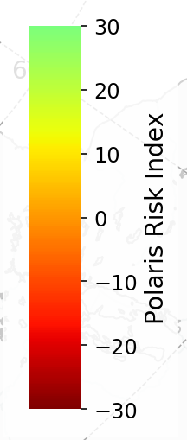
ADAC Program Year 7 Annual Meeting 2-3 June 2021
Arctic Ice Conditions Index (ARCTICE)
Case Study: Russian LNG
Different vessel types encounter more challenging conditions

Slide 26
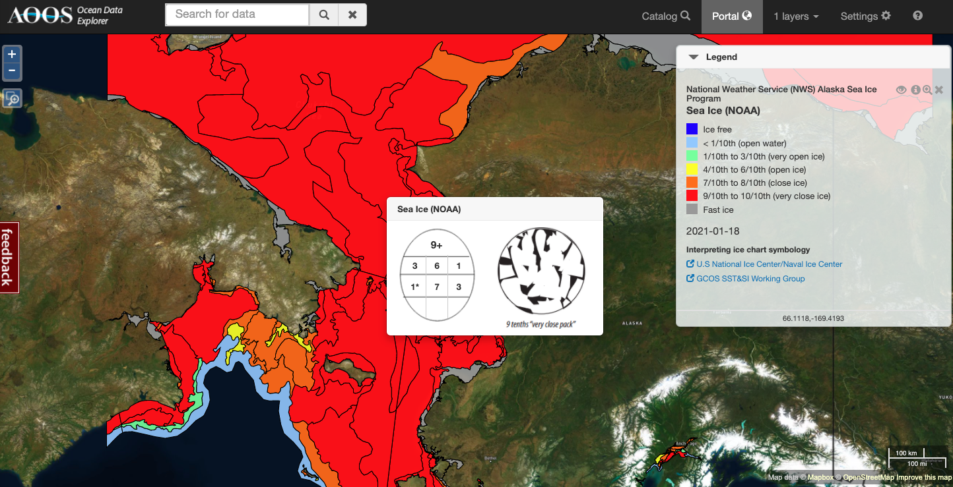
ADAC Program Year 7 Annual Meeting 2-3 June 2021
Arctic Ice Conditions Index (ARCTICE)
Case Study: Russian LNG
What did the sea ice look like on 1/16/2021 when the Christophe de Margerie passed through the Bering Strait?
# | Sea Ice Thickness
1* | 70-120 cm
7 | 30-70 cm
3 | 10-15 cm
Takeaway: Ice was below the 1.4 m Arc7 class max thickness and PC3 1.3 m max thickness requirements

Slide 27
ADAC Program Year 7 Annual Meeting 2-3 June 2021
Great Lakes Ice condition index (ICECON)
Update
Product delivered to D9 and USNIC from December 2020 to April 2021;
Per USNIC’s evaluation ‘overall, ICECON seems to be doing well’;
Occasionally the ICECON model overestimates the ice condition, but per analysis by USNIC, ‘it has been pretty easy to trace the errors back to WCPS (the input data).’
There have been some occasions where the WCPS model over-estimated freeze up or did not melt out enough ice as winds pushed the ice offshore toward warmer water. Since the WCPS model had an error, that error just translated over to ICECON.

Slide 28
ADAC Program Year 7 Annual Meeting 2-3 June 2021
Great Lakes Ice condition index (ICECON)
Update
Android app delivery to D9 delayed into the ice season due to D9’s transition to iOS devices and the additional requests for data encryption;
Additional work with USCG WWM and D9 to revise the app to add 2-way communications between the ICECON model and ship observations (year 8 task).

Slide 29
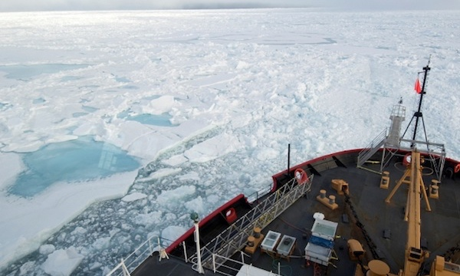
ADAC Program Year 7 Annual Meeting 2-3 June 2021
Ready for Questions
Feedback…
What are we missing?
What can we improve?
Who should we connect with to improve odds of research success?
Notes:
Thank you for the gift of your time and attention.

